Slide 1
Kieran/Mike ACI Fraud solution
Real-time screening
Go through each layer and merits e.g., real time; rule types; profiling; fraud analysts; ML; data scientists; retrospective screening;
Incremental benefits slide – showing % benefits of each layer
Retrospective screening – CHECK eta (Jackie)
Profiling – positive/negative
Consortium data (Hadoop benefits)
New UIs ACI ReDi and CSI demos
*New* Feature Manager – what and benefits
*New* Control Centre (single sign-on)
*New* Rule Manager what and benefits
*New* List manager what and benefits
Batch analytics
ACI ReD Shield can fraud check ANY event i.e., loyalty systems, log-on information.

Slide 2
ACI Does Deliver Very Good Metrics
ACI risk analysts delivered a
To get our merchants to the best possible set of KPIs for their business – a unique service
51%
ACI risk team will work with merchant to define a bespoke strategy to deliver desired KPIs
improvement by focusing on optimizing performance through multi-layered
platform tools
Case Study – Challenge Rate |  | 4.25%
Improvement Initiatives | Uplift % | Revised Rate
1. Service Review from Risk | 25% | 3.21%
2. Case Manager (Auto Analyst) | 10% | 2.95%
3. SAE Positive Profiling | 15% | 2.66%
4. Data Mapping Upgrade | 10% | 2.43%
5. New Machine Learning Model | 8% | 2.21%
6. ACI ReDi™ Dashboards – Profiling | 8% | 2.08%
ACI Rate – 51% Improvement |  | 2.08%

Slide 3
Multiple Layers of Control Delivers KPIs
Machine Learning Pattern recognition Client-specific and sector models
Positive Profiling Enhanced detection, increased acceptance
Consortium Data Shared global fraud intelligence for rapid response to related fraud trends
Rules Simple accept/deny or sophisticated rule sets, tailored by product, sector, channel and country; real-time rule manager; silent rules for testing
Retrospective Monitoring Automated decisioning; real-time and retrospective screening
Supplementary Services Easy callout to specialist third-party services as required
Business Analytics and Reporting Near-real-time and historic view for performance management and reporting
Expert Risk Analyst Fraud strategies, risk reviews, real-time support from analysts with sector expertise
Minimal technical setup, rapid go-live, managed by users through ACI’s Control Center
Multi-layered decisioning takes advantage of information that is available at or before authentication and during authorization. The use of multiple tools such as device information, geo or IP location, behavioural biometrics, and scoring using Artificial Intelligence provide a wealth of opportunities to determine the risk associated with a transaction” - Mastercard

Slide 4
Multiple Layers of Control Delivers KPIs
Positive Profiling
Enhanced detection, increased acceptance
Enhances number of fields that define the risk of a consumer — In rules/models far less risk when history is made available and should always be a filter in rules.
Rules
Simple accept/deny or sophisticated rule sets, tailored by product, sector, channel and country; real-time rule manager; silent rules for testing
Rules will be the primary source of the platform performance. TRE will enhance the amount and types of rules through ability to build any feature, condition, lists on any data field.
Supplementary Services
Easy callout to specialist third-party services as required
ACI can enhance the data mapping with additional providers such as Iovation with device fingerprinting. More data will enhance the final set of rules.
Expert Risk Analyst
Fraud strategies, risk reviews, real-time support from analysts with sector expertise
Any technology requires human expertise as fraud trends evolve fast and rules require constant monitoring and review. ACI analysts know the platform inside out and will ensure optimal KPIs are achieved. Fraud requires people, process and technology alignment.

Slide 5
Multiple Layers of Control Delivers KPIs
ML is the biggest growth area in fraud management where users expect the models to be able to identify trends — the models create thousands of profiles and scores each to define a total risk factor. ACI modeling will significantly improve under the Titanium developments.
Machine Learning
Pattern recognition Client-specific and sector models
Consortium Data
Shared global fraud intelligence for rapid response to related fraud trends
Consortium is key to defining KPIs — false positives and rule performance. ACI uses this negatively, positively and retrospectively and holds a market leading volume of fraud intelligence.
Fraud trends emerge post-transaction so it is critical that the platform is able to alert to new and evolving intelligence = RFX and silent rule monitoring enable users to constantly stay aligned to emerging trends.
Retrospective Monitoring
Automated decisioning; real-time and retrospective screening
Successful fraud strategies are defined by KPIs so ACI has invested heavily in building dashboards and reports across every component of the end-to-end strategy. Immediate response to adverse KPIs is fundamental so rules can evolve with substantiated evidence through BI.
Business Analytics and Reporting
Near-real-time and historic view for performance management and reporting

Slide 6
Multiple Layers of Control Delivers KPIs
Rules
Simple accept/deny or sophisticated rule sets, tailored by product, sector, channel and country; real-time rule manager; silent rules for testing
Deny where >3 cards per email in 24 hours and IP country <> delivery country
Machine Learning
Pattern recognition Client-specific and sector models
And prism score > 750
Positive Profiling
Enhanced detection, increased acceptance
And card history < 3 days and email (ACI ReD Shield) < 10 days
Supplementary Services
Easy callout to specialist third-party services as required
And device = mobile
Consortium Data
Shared global fraud intelligence for rapid response to related fraud trends
Rule hits 28 times with 8 fraud links
Rule performance, fraud detection and profiling shows KPIs associated with rule
Business Analytics and Reporting
Near-real-time and historic view for performance management and reporting
Retrospective Monitoring
Automated decisioning; real-time and retrospective screening
RFX identifies emerging fraud on delivery location
Risk analyst able to adjust rule to fit the latest intelligence from ACI ReDi, consortium and RFX
Expert Risk Analyst
Fraud strategies, risk reviews, real-time support from analysts with sector expertise

Slide 7
Multiple Layers of Control Delivers KPIs
Machine Learning Pattern recognition Client specific and sector models
Deny where > 3 Cards per email in 24 hours and IP country <> delivery country and machine learning score > 750 and card history < 3 days and email (ACI ReD Shield) < 10 days and device = mobile
Consortium Data Shred global fraud intelligence for rapid response to related fraud trends
Efficiency and effectiveness managed through:
Rule Manager delivers immediate changes [flexibility]
Consortium data tracks rule against emerging fraud [false positives]
ACI ReDi dashboards rule performance 24/7 [control]
Silent option allows for testing and offline monitoring [optimizing approval rates]
Risk team able to support platform performance [support]
RFX will alert on fraud that was subsequently approved [reduce exposure]
Machine learning will adapt to new trends [artificial intelligence]
Data mapping and profiling will highlight key data areas of risk ([data/consumer intelligence]
CSI will enable visibility of linked analysis and blacklisting [scope of fraud/immediacy]
Device fingerprint will help define transaction source [data]

Slide 8

Project Titanium – Processing and Intelligence Overview
Real-Time
Decision Making
Strategies / Data Science
Business
Support
Machine
Learning
Data Fabric
(Big Data)
Environment
Business
Intelligence
Visual Data Exploration
Patterns
Algorithms Strategies
Information
Social
Analytics
Enriched GUI
Decision
Science
Rule Strategies
Extensibility
Analytic
Engines
Features
Rules
Models
Reusability
Relational
Lambda
Kappa

Slide 9









Project Titanium – Platform Architecture/Vision
Partners
UP® Payments Risk Management™ and Risk Orchestration
Clients/ Segments
Authentication
Risk Services
Deployment Options
Data Providers
Challenge
Alert management
Synthetic ID
Case management
DeviceID
Rule manager
On-premise
Bank/Issuer
Email
Model manager
Service Providers
Biometric
BI/reporting/dashboards
Mobile
ACI Proactive Risk Manager™
Stream analytics (CEP)
Batch analytics
Processor/ Intermediary
SMS/Whatsapp
Case Management
Model execution
Capabilities
Cloud
ACI ReD Shield®
AML
Universal scoring engine (ML)
PRISM scoring engine (ML)
Merchant
Third-Party Data
Rules/analytics data store (Esper, Cassandra, Gemfire)
External Data
Consortium
Big data repository (Hadoop)
ReDi

Slide 10
Project Titanium: Strong Results to Date (Q3 2019)
DETECTION:
Material uplifts in fraud detection KPIs
Delivery of multiple machine learning models at sector level (total four today versus only one model option over past 10+ years)
Significant false positive reduction through Stream Analytics profiling
Enhanced rule creation (extra data and rule logic)
PROCESSING:
TPS (transaction per second) improvements
Capacity
Improvements to UAT, boarding, connectivity, interfacing through the ACI PAY.ON® Payments Gateway™. (Single sign-on, reporting, tieback, CV2 AVS)
Significant improvements in NFRs across 2018/2019
Notes:
Suggesting an overview slide like this rather than the complicated next slide that doesn't explain how ACI will deliver. We can SHOW them how in the detail slides for each advancement.

Slide 11
Titanium Focus – Focus on Actual Business Benefits
NFRs
To improve TPS, capacity, speed and uptime
Rule Capabilities
Rules on all data components based on combination of features, conditions and lists management
Machine Learning
Structure database to adapt to emerging AI technologies and automated detection/intelligence
Rule Types
Add merchant monitoring, enterprise fraud and other risk checks to consumer-based monitoring
User Interfaces
More millennial and intuitive user experience driving efficiencies and consistency across the platform
Cost to Operate
Containerization and more efficient hardware to support expansion
Notes:
Delivered in the cloud – supported by a dedicated risk team. This describes the flow of a transaction.
Please note that there are many different modules being called for every transaction and depending on risk each is customised per merchant
At a very high level:
ReD Shield = Real Time decision is made
CSI = allows review agents to view a single transaction that may have a high possibility of fraud (it is then reviewed and manually moved to decline or accept (can be automated via TIEBACK)
Third Party = IP Geolocation, Device Fingerprint, Consortium database, Prism model are the main call-outs (some are ACI inhouse and some are third party calls and require additional work
ReDi = Where all KPIs are managed via dashboards, reportings and ability to drill into transaction data CRITICAL FOR OPTIMISING THE STRATEGY. Most important module!!!!
RFX = Where a transaction that was previously screened is alerted if it now matches a fraud data point. Sits within ReDi and differentiator for ACI
The diagram that animates at the bottom summarises how the platform delivers results across a timeline – NOT JUST RELATIME. Please refer to each deliverable in ORANGE (self explanatory)

Slide 12
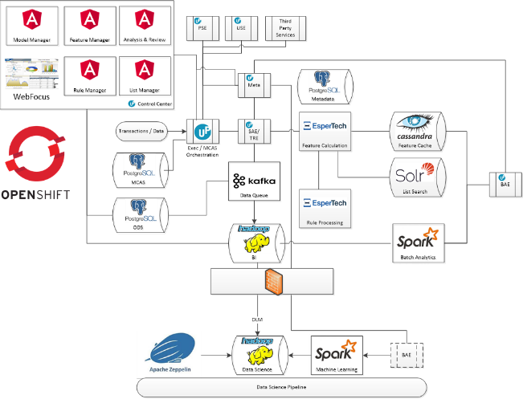
Titanium – NFRs
Modern architecture
Container-based
Cloud-ready
Elasticity
Ready to meet your demands
Quick value delivery
ACI own data centers
Notes:
Delivered in the cloud – supported by a dedicated risk team. This describes the flow of a transaction.
Please note that there are many different modules being called for every transaction and depending on risk each is customised per merchant
At a very high level:
ReD Shield = Real Time decision is made
CSI = allows review agents to view a single transaction that may have a high possibility of fraud (it is then reviewed and manually moved to decline or accept (can be automated via TIEBACK)
Third Party = IP Geolocation, Device Fingerprint, Consortium database, Prism model are the main call-outs (some are ACI inhouse and some are third party calls and require additional work
ReDi = Where all KPIs are managed via dashboards, reportings and ability to drill into transaction data CRITICAL FOR OPTIMISING THE STRATEGY. Most important module!!!!
RFX = Where a transaction that was previously screened is alerted if it now matches a fraud data point. Sits within ReDi and differentiator for ACI
The diagram that animates at the bottom summarises how the platform delivers results across a timeline – NOT JUST RELATIME. Please refer to each deliverable in ORANGE (self explanatory)

Slide 13



Titanium – Machine Learning
DLM
BAE
Data Science
Machine Learning
Apache Zeppelin
Data Science Pipeline
Hadoop integration structures data for machine learning and current traffic already in UAT in new environment
ACI have eight dedicated decision scientists for in-house model development so has full control of AI destiny
Enables immediate model updates
Dynamic learning
Multiple model options possible VERSUS today with Prism neural scoring
Notes:
Delivered in the cloud – supported by a dedicated risk team. This describes the flow of a transaction.
Please note that there are many different modules being called for every transaction and depending on risk each is customised per merchant
At a very high level:
ReD Shield = Real Time decision is made
CSI = allows review agents to view a single transaction that may have a high possibility of fraud (it is then reviewed and manually moved to decline or accept (can be automated via TIEBACK)
Third Party = IP Geolocation, Device Fingerprint, Consortium database, Prism model are the main call-outs (some are ACI inhouse and some are third party calls and require additional work
ReDi = Where all KPIs are managed via dashboards, reportings and ability to drill into transaction data CRITICAL FOR OPTIMISING THE STRATEGY. Most important module!!!!
RFX = Where a transaction that was previously screened is alerted if it now matches a fraud data point. Sits within ReDi and differentiator for ACI
The diagram that animates at the bottom summarises how the platform delivers results across a timeline – NOT JUST RELATIME. Please refer to each deliverable in ORANGE (self explanatory)

Slide 14
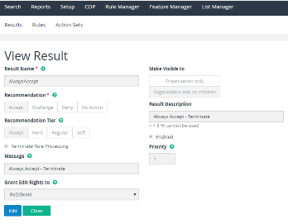
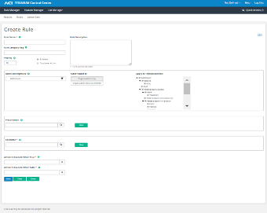
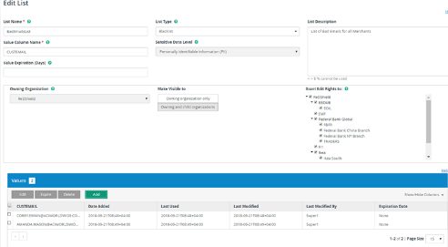
Titanium – User Interfaces
Majority of UI is built and now going through extensive testing and user feedback programs
Includes Rule Manager, Feature Builder, Business Intelligence and Control Center
Notes:
Delivered in the cloud – supported by a dedicated risk team. This describes the flow of a transaction.
Please note that there are many different modules being called for every transaction and depending on risk each is customised per merchant
At a very high level:
ReD Shield = Real Time decision is made
CSI = allows review agents to view a single transaction that may have a high possibility of fraud (it is then reviewed and manually moved to decline or accept (can be automated via TIEBACK)
Third Party = IP Geolocation, Device Fingerprint, Consortium database, Prism model are the main call-outs (some are ACI inhouse and some are third party calls and require additional work
ReDi = Where all KPIs are managed via dashboards, reportings and ability to drill into transaction data CRITICAL FOR OPTIMISING THE STRATEGY. Most important module!!!!
RFX = Where a transaction that was previously screened is alerted if it now matches a fraud data point. Sits within ReDi and differentiator for ACI
The diagram that animates at the bottom summarises how the platform delivers results across a timeline – NOT JUST RELATIME. Please refer to each deliverable in ORANGE (self explanatory)

Slide 15
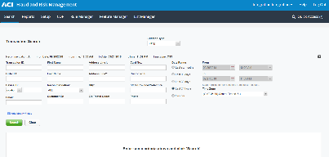
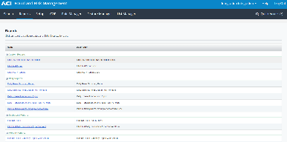
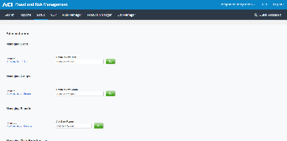
Control Center – CSI (Customer Service Interface)
New Look and Feel
Search
Reports
Set Up and Manage Users
Key Benefits
Provides access to:
New Feature Manager
Rule Manager
List Manager
CSI
Notes:
Fresh look; Titanium project s bigger than just ReD shield and will ultimately bring in other ACI products to create a unified look and feel

Slide 16
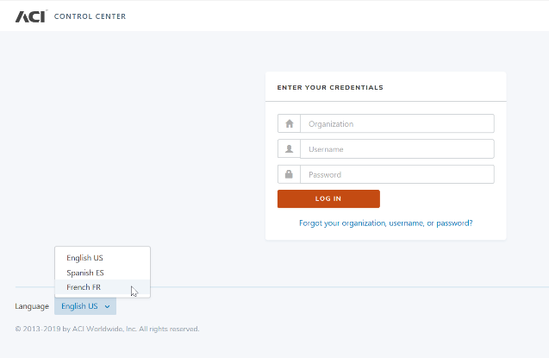
Control Center – Next Gen
Multilingual Capability
Key Benefits
Language options
Multilingual support

Slide 17
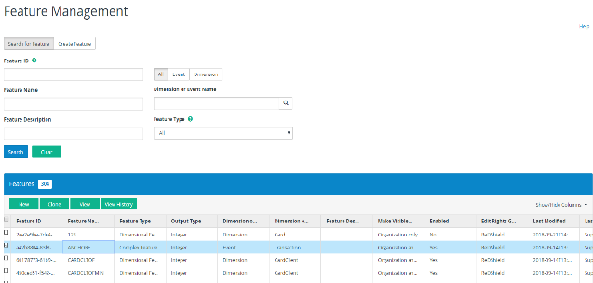
Feature Manager
Using Data Effectively and Efficiently
Features
Create new features or select from template library to create:
Dimensional features
Complex features
Access all transactional data points
Apply condition: Count/sum/avg spend/standard deviation
Key Benefits
Improves fraud detection; reduces false positive and optimizes accept rates because:
Uses extended data history – 24 months data (instead of current 30 days)
Count, sum, average, percent (%) deviation, min, max and medium spend​ (instead of just count and sum)
Increased data field availability
View, add, edit and delete all data features through the user interface

Slide 18
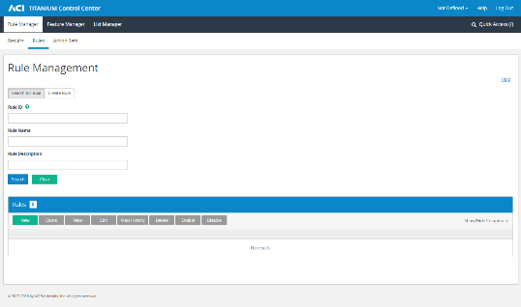
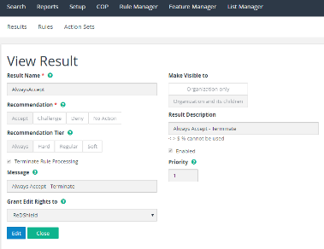
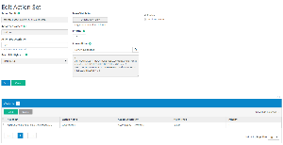
Rule Manager
Create
Features
Edit view and action on rules
Allows for the creation and edit of rules
Uses transactional data
Features (from Feature Manager)
Or lists (from List Manager)
Create results and actions sets
Actions – define what action to take next after rule result is reached
E.g., accept/challenge/deny
Or go to another rule
The hierarchical structure now allows for multiple IF rules to be used
Key Benefits
More granular analytics to ensure better decisions are reached
Assign rules to individual client/sub-client(s) or all customers
Define rule name, category, description, priority
Customer friction minimized
Increased performance
Scalable

Slide 19
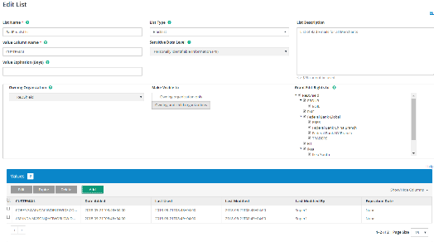
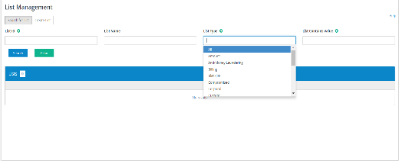
List Manager
Import
Features
Click and block lists of data or create new lists to use in Feature Manager and rules
Create lists to use in Feature Manager and Rules
Including the ability to create specific lists – i.e., Risky IP address, whitelist cards, etc.
Replaces click and block
Accessed via CSI2 control center UI
Puts the creation and maintenance of the lists in the hands of the customer.
Lists to be created on a global or per customer level, for use within rules, which will significantly limit the number of rules required in the system.
Key Benefits
Puts the customer in full control of the management and maintenance of lists for whitelisting or backlisting purposes
No need to call Global HELP24™/risk team (as current) to add lists to click and block
Performance improvements as customers can create a single rule that references a list vs. creating a rule with specific emails, card numbers

Slide 20
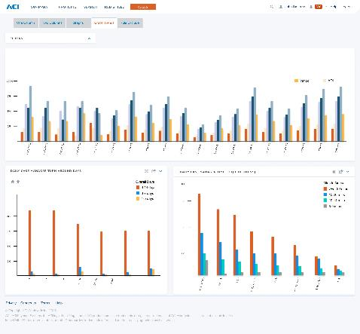
ACI ReDi Next Gen
Improved Layout and Presentation of Data
Features
Charts are clear and easy-to-read/spot trends and outliers
Research into color theory and color palettes informs those choices to produce visualizations that are optimized for human perception
Key Benefits
Better decision support

Slide 21
ACI ReDi Business Intelligence
Purpose
Multilingual Capabilities
Updated BI ACI ReDi platform to enhance non-functional requirements and integration capability
Security and entitlement enhancements
Performance enhancements for BI/reporting/data exploration
English
Spanish
Portuguese
German
Enables
French
Updated dashboard components
Business intelligence exploration
Faster data analysis
Lightweight ML/PMML model creation
Removal of 5K line limit
Chinese
Italian
Japanese
Technologies
Russian
BI platform engine
Hadoop/Spark/Hive/LLAP
Romanian
Turkish

Slide 22
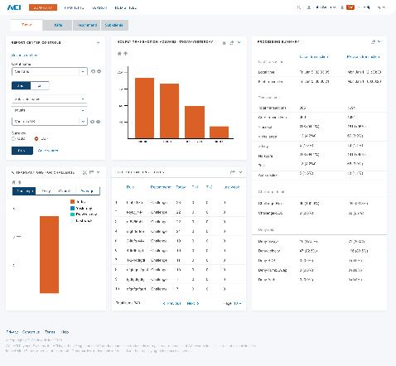
ACI ReDi Next Gen
Report Center Controls Section
Features
Dashboard with reports
Report Center Controls section allows the user to define the content they are looking for and then “lock” those criteria for the entire dashboard — all tabs
Key Benefits
With one set of criteria, the entire dashboard reflects those values

Slide 23
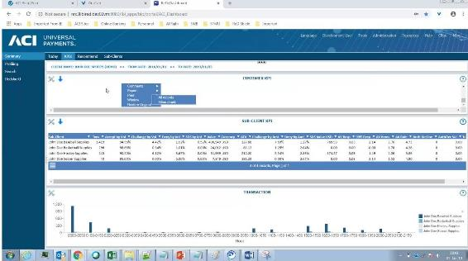
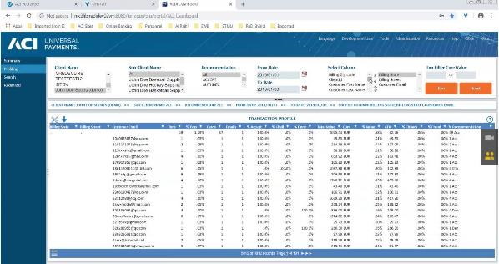
Business Intelligence
ACI ReDi on Hadoop environment for data enrichment
Profiling Capabilities
Fraud KPI Metrics

Slide 24
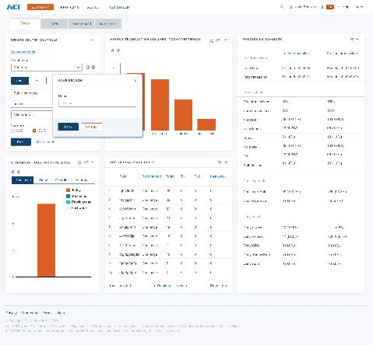
ACI ReDi Next Gen
Create and Save Customized Dashboard Views
Features
Criteria can be saved and easily accessed for future use
Key Benefits
Frequently used search strings don’t have to be re-entered

Slide 25
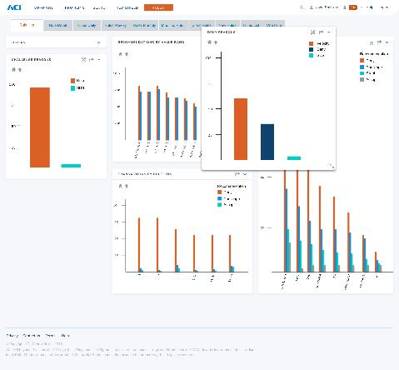
ACI ReDi Next Gen
Consolidate and Compare Charts Across Tabs
Features
Reports can be undocked from any tab and pinned to the top
Key Benefits
Reports can be easily compared across tabs

Slide 26
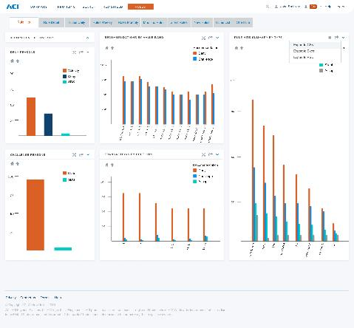
ACI ReDi Next Gen
Exporting Data Into Alternative Formats
Features
All bar charts feature an “Export” option
Key Benefits
Further analysis using Excel or any other data analysis tool that can import CSV or XLS files

Slide 27
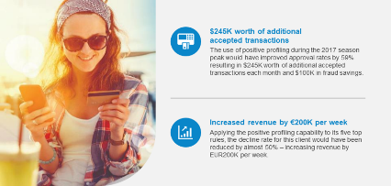
Titanium – Rule Capabilities
Titanium Rules Engine (TRE) already released positive profiling (SAE) to enhance profiling and rule capabilities
Now testing batch analytics (BAE phase)
Velocity Rule Types | Count/sum/average/% deviation/Min, Max and medium spend | Count and Sum only
Rule Outcomes | Ability to execute actions when rules are TRUE or false | Ability to execute actions only when rules are TRUE
Rule Prioritization | Prioritize every feature and rule through GUI | Five priority tiers, only controllable through back-end code
Rule Set Management | Fully manage rule sets via GUI | Only able to add rules to ruleset through GUI. Other management controlled through back-end code.
Rule Recommendation Options | Ability to create custom recommendations through GUI | No customization available
Notes:
Delivered in the cloud – supported by a dedicated risk team. This describes the flow of a transaction.
Please note that there are many different modules being called for every transaction and depending on risk each is customised per merchant
At a very high level:
ReD Shield = Real Time decision is made
CSI = allows review agents to view a single transaction that may have a high possibility of fraud (it is then reviewed and manually moved to decline or accept (can be automated via TIEBACK)
Third Party = IP Geolocation, Device Fingerprint, Consortium database, Prism model are the main call-outs (some are ACI inhouse and some are third party calls and require additional work
ReDi = Where all KPIs are managed via dashboards, reportings and ability to drill into transaction data CRITICAL FOR OPTIMISING THE STRATEGY. Most important module!!!!
RFX = Where a transaction that was previously screened is alerted if it now matches a fraud data point. Sits within ReDi and differentiator for ACI
The diagram that animates at the bottom summarises how the platform delivers results across a timeline – NOT JUST RELATIME. Please refer to each deliverable in ORANGE (self explanatory)

Slide 28
Titanium – Rule Types
Merchant monitoring – Ability to build rules based on merchant activity instead of consumer calculating periodic or cumulative comparisons (variance today vs. yesterday)
Real-time rules (RTR) – Ability to define history tables for velocity and also add conditions to when rules are triggered (specific to enhanced velocity rules)
Scoring – Addition of a score per rule to overall risk of the transaction
Dedicated rules for multiple risk strategies: Authentication (SCA/PSD2), returns fraud, transaction or payment updates to original transaction, credit risk and registration channels with strategies and rules for acquirers, merchants and PSPs
New business intelligence dashboards to manage rules/profiles
SKU level/more granular data to build business rules (control units sold for example)
Notes:
Delivered in the cloud – supported by a dedicated risk team. This describes the flow of a transaction.
Please note that there are many different modules being called for every transaction and depending on risk each is customised per merchant
At a very high level:
ReD Shield = Real Time decision is made
CSI = allows review agents to view a single transaction that may have a high possibility of fraud (it is then reviewed and manually moved to decline or accept (can be automated via TIEBACK)
Third Party = IP Geolocation, Device Fingerprint, Consortium database, Prism model are the main call-outs (some are ACI inhouse and some are third party calls and require additional work
ReDi = Where all KPIs are managed via dashboards, reportings and ability to drill into transaction data CRITICAL FOR OPTIMISING THE STRATEGY. Most important module!!!!
RFX = Where a transaction that was previously screened is alerted if it now matches a fraud data point. Sits within ReDi and differentiator for ACI
The diagram that animates at the bottom summarises how the platform delivers results across a timeline – NOT JUST RELATIME. Please refer to each deliverable in ORANGE (self explanatory)

Slide 29
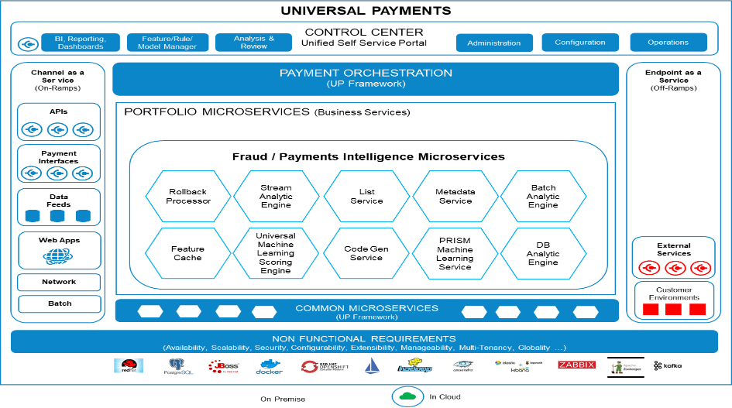
Titanium – Cost to Operate
Notes:
Delivered in the cloud – supported by a dedicated risk team. This describes the flow of a transaction.
Please note that there are many different modules being called for every transaction and depending on risk each is customised per merchant
At a very high level:
ReD Shield = Real Time decision is made
CSI = allows review agents to view a single transaction that may have a high possibility of fraud (it is then reviewed and manually moved to decline or accept (can be automated via TIEBACK)
Third Party = IP Geolocation, Device Fingerprint, Consortium database, Prism model are the main call-outs (some are ACI inhouse and some are third party calls and require additional work
ReDi = Where all KPIs are managed via dashboards, reportings and ability to drill into transaction data CRITICAL FOR OPTIMISING THE STRATEGY. Most important module!!!!
RFX = Where a transaction that was previously screened is alerted if it now matches a fraud data point. Sits within ReDi and differentiator for ACI
The diagram that animates at the bottom summarises how the platform delivers results across a timeline – NOT JUST RELATIME. Please refer to each deliverable in ORANGE (self explanatory)

Slide 30
Service by Type and Location
Service Type | Provider Name | Global | EMEA | North America | Canada | LATAM | APAC | Notes
Device ID | Iovation |  |  |  |  |  |  | Chargeable
 | Threatmetrix |  |  |  |  |  |  | Chargeable
Outsourced manual reviews | Arvato Bertelsmann |  |  |  |  |  |  | Chargeable
Chargeback representment | Chargebacks911 (*) |  |  |  |  |  |  | Referral agreement – chargeable
Address verification | Canada Yellow Pages |  |  |  |  |  |  | No charge
 | Google maps |  |  |  |  |  |  | No charge
 | Discover verify + |  |  |  |  |  |  | No charge
 | WhitePages |  |  |  |  |  |  | Referral agreement – chargeable
 | Intelius |  |  |  |  |  |  | No charge
 | Zaba search |  |  |  |  |  |  | No charge
 | Yellow pages |  |  |  |  |  |  | No charge
 | Neustar Targus |  |  |  |  |  |  | Chargeable

Slide 31
Service by Type and Location
Service Type | Provider Name | Global | EMEA | North America | LATAM | APAC | Notes
Email verification | Emailage ( 2019) |  |  |  |  |  | Chargeable
 | PIPL |  |  |  |  |  | No charge
 | Neustar Targus |  |  |  |  |  | Chargeable
 | WhitePages |  |  |  |  |  | Chargeable
Phone verification | Zaba search |  |  |  |  |  | No charge
 | Intelius |  |  |  |  |  | No charge
 | Discover Verify + |  |  |  |  |  | No charge
 | WhitePages |  |  |  |  |  | Referral agreement – chargeable
IP address verification | Neustar Quova |  |  |  |  |  | No charge
 | Utrace |  |  |  |  |  | No charge
 | WHOIS.net |  |  |  |  |  | No charge
Airline fraud - IATA | Perseuss |  |  |  |  |  | Chargeable

Slide 32
Session questions
Name 3 of 6 Improvements Initiatives in the example on 51% optimisation?
Name 3 of 5 improvements under the Machine Learning Pipeline for ACI?
Name 3 benefits of new Rule Manager?
Name 3 benefits of the new BI in IBI?
Name 3 benefits of the new Feature Manager?
What are ACIs 8 Layers of Control?

